Slide 1

How To Guide: Connection Security
Jasmine Roberts
CTEC-450-102 Case Studies in Computer Security
Dr.Jackson

Slide 2

Overview of Connection Security Slides 3-5

Slide 3

What is Connection Security?
What is Connection Security’s signifigance in modern computing?
A connection that uses encryption protcols to protect the data being transferred
Protects the data from unauthorize use
Authenticates the recipient of the data
Ensures that the data has not been tampered with (Secure Connection Definition, n.d.)
Provides the protection for the computers:
Data
System
Network(s)
Without the significance of Connection Security there will be many forms of bad intent against modern computing. The computer’s connection would not be safe to use.

Slide 4
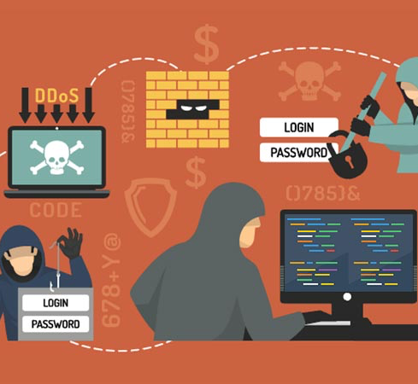
Potential Threats and Vulnerabilites
Threats:
Hackers can:
Access Information
Gain access to the network
Viruses/Malware can be transmitted
Hijack internet connection
Vulnerbailites:
Unnecessarily open ports
Insecure network protocols

Slide 5


Real World Examples: Security Breaches Resulting From Compromised Connections
Yahoo! INC Data Breach (2013-2014):
A team of Russian hackers targeted Yahoo’s database using backdoors, stolen backups, and access cookies to steal records from all user accounts (Chin, 2024)
Over 3 billion user accounts exposed, as far as their names, email addresses, phone number, birth dates, passwords, secuirty questions (Team, 2024)
They were hacked because of the lack of security measures
The hackers were able to bypass the basic security meausres
Since then, to enhance secuirty Yahoo:
hired a chief information security officer
invalidating uneccrypted security questions
asking users to change their passwords often

Slide 6
Encryption Techniques Slides 7-9

Slide 7
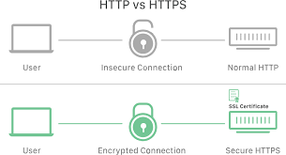

Encryption within Connection Security
Converts information into an unreadable format
Allows information owners to keep data confidential
It conceals the connections as they pass between nodes
Algorithms and secuirty keys are used
Includes montioring, segmentation, access mangment, and secuirty polices (Network Encryption: What is and how does it work?, n.d.)

Slide 8
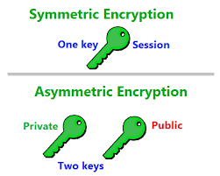
Symmetric and Asymmetric Encryption Algorithms
Symmetric
Asymmetric
Used to transmit big data
128 or 256-bit key size
Uses a single key for encryption and decryption
Works on low usage of resoureces
Mostly used within securing large amounts of data, files and protecting data in transit
Used to transmit small data
RSA 2048-bit or higher key size
Uses two keys for encryption and decryption:
-one public
-one private
Requires high consumption of resoruces
Most used within TLS/SSL, digital signatures and authentication

Slide 9
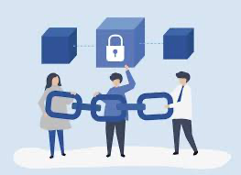
Importance of key Management: Ensuring Secure connection
Is the process of generating exchanging, storing and manaing cryptographic keys
This allows the connection to be encrypted and secure
If there is poor key management, it can lead to:
- unauthorized access
- data loss
- data breaches
Key mangement is the cornerstone of ensuring a secure connection because of its encryption methods (Badman & Kosinski, 2024)

Slide 10
Secure Network Protocols Slides 11-12

Slide 11

Common Network Protcols: Secure Communication
Hypertext Transfer Protocol over SSL/TLS (HTTPS)
The foundation of data communication on the World Wide Web
Adds encryption and data integrity through SSL/TLS
Uses asymmetric and symmetric encryption
Is mainly used for secure web browsing, online transcations, communcations, and protecting sensitive information
Strenghts:
Lower CPU and memory usage due to less connections
Reduces network congestion
Reports errors with closing the TCP connection
Weaknesses:
Uses a lot of server resources: power and memory encryption
Latencies: can cause delays on its set up
Secure Shell (SSH)
Cryptographic network protocol
Used to secure access and manage network devices remotely
Provides secure encrypted communications between the client and the server
Uses public key to authenticate
Strenghts:
High Security: end-to-end encryption to protect data communciations
Secure Authenctication: to identify and verify users that are connecting
Flexibility: can be used for vaiorus purposes
Weaknesses:
Vulnerability to Brute Force Attacks: attackers can attempt multiple password combinations to gain unauthoirized access
Requires a Stable Internet Connection: if the internet is unstable it can results into difficulties within the communications of SSH

Slide 12

Scenarios: HTTPS and SSH
Secenario 1
HTTPS
For example, when an online bank website requires users to login and perform finicacial trasnscations, HTTPS encrypts the data transmitted preventing unauthoized access and making security the security of sensitive information. Any website that reuires login credential, should use HTTPS (What is HTTPS?, n.d.)
Scenario 2
SSH
For example, when a system administrator needs to remotely manage a server located in a private network, SSH provides secure access and data transfer.
Notes:
https://www.technologygee.com/what-is-the-secure-shell-ssh-protocol/#google_vignette
https://www.cloudflare.com/learning/ssl/what-is-https/#:~:text=Hypertext%20transfer%20protocol%20secure%20(HTTPS,HTTPS%20websites%20as%20not%20secure.

Slide 13
Implementing Connection Security Slides 14-17

Slide 14

Best Practices: Implementing Connection Security
Enterprise Networks
IoT Devices
Implementing Connection Security inside of Enterprise Networks by:
Dividing your enterprise into zones
Use both hardware and software firewalls
Use network ssecurity solutions
Use VPN’s
Estiablish a zero-trust plan
Regualry conduct security audits
Install updates
Implementing Connection Security inside of IoT Devices by:
Implement Access Controls
Strong Authentication
Regularly update firmware
Segment IoT devices on seperate networks
Encryption
Monitor Network Traffic
Notes:
https://brandefense.io/blog/drps/strategies-for-securing-internet-of-things-iot-devices/#:~:text=Implement%20Strong%20Authentication%20and%20Access,can%20interact%20with%20the%20devices.
https://www.liquidweb.com/blog/enterprise-network-security/

Slide 15
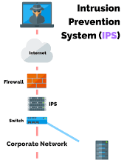
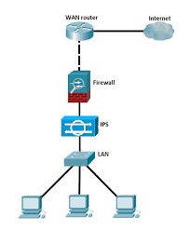
FireWalls, Intrusion Detection/ Prevention Systems: Enhancing connection Security
Firewalls:
Firewalls can enhance connection security by shielding your computer from bad intent within network traffic. It acts as a barrier between your network and the potential harmful environments. Firewalls only operate by analyzing your network traffic, which can result to tracking the state of active connections and making sure it is apart of a trusted source (How Firewalls Enhance Network Security, n.d.)
Intrusion Detection/Prevention Systems:
Intrustion Detection/Prevention Systems can help enhance connection security by helping you analyze network traffic in real time. It takes actions to prevent threats from affecting the network automatically, These systems are great at keeping tack and logging data events to be reviewed (Network Secuirty Intrusion Detection Prevention, n.d.)
Notes:
https://www.azion.com/en/learning/websec/how-firewalls-enhance-network-security/
https://www.tatacommunications.com/knowledge-base/network-security-intrusion-detection-prevention/

Slide 16

How to Configure Secure Connections using SSH anD HTTPS
SSH
HTTPS
Choose a webserver: Apache
Enable SSL/TLS Module
Create a Private Key: OpenSSL can be used to create a private key
Generate a CSR
Obtain an SSL/TLS Certifcate
Install the Certificate: Use the SSL/TLS certificate and private key
Configure HTTPS Setting: Confugre your web browser to listen on Port 443
Test Configuration
Obtain a Certificate
Generate a Private Key: OpenSSL can be used to generate a private key
Request a Certifcate: the private key will be used to request
Configure your Server: Identify Protocol, Configure Server Software, Enbale TLS/SSL
Configure Clients: Client Authentication, Test the Connection
Notes:
https://www.ssl.com/guide/ssl-best-practices/
https://docs.redhat.com/en/documentation/red_hat_streams_for_apache_kafka/2.5/html/developing_kafka_client_applications/assembly-kafka-secure-config-str
https://medium.com/@ravipatel.it/step-by-step-guide-creating-installing-and-configuring-ssl-certificate-on-apache-server-vm-7587193dbef6

Slide 17

Blockchain and Quantum Cryptography: To Reshape Connection Security Stragegies
Blockchain
Quantum Cryptography
Blockchain provides:
Cryptography
Tamper-proof data storage
Enhanced Security
Enhanced Identity Management
Continous Montoiring/Auditing
Offers a transparent system reducing single points of failure
Cannot be altered
Integrity of information
Quantum Cryptography provides:
Quantum Key Distribution: enables two parties to share on secret key
Eavesdropping Detection
Resilience to Quantum Computers
Quantum-Safe Cryptography
Ubreakable encryption
Notes:
https://www.pymnts.com/blockchain/2025/blockchains-new-identity-paradigm-helps-reimagine-enterprise-cyber-protection/#:~:text=Blockchain%2Dbased%20identity%20credentials%20can%20ensure%20that%20only,reliance%20on%20vulnerable%20passwords%20and%20centralized%20databases.

Slide 18
References
Works Cited
Badman, A., & Kosinski, M. (2024, September 6). What is key management? Retrieved from IBM: https://www.ibm.com/think/topics/key-management
Cavanagh, L. (n.d.). Enterprise NEtwork Secuirty: 10 best practices to secure your enterprise network. Retrieved April 2025, from Liquid Web: https://www.liquidweb.com/blog/enterprise-network-security/
Chapter 5: COnfiguring secure connections. (n.d.). Retrieved April 2025, from Red Hat Doucmentation: https://docs.redhat.com/en/documentation/red_hat_streams_for_apache_kafka/2.5/html/developing_kafka_client_applications/assembly-kafka-secure-config-str
Chin, K. (2024, December 30). Biggest Data Breaches in US History. Retrieved from UpGuard: https://www.upguard.com/blog/biggest-data-breaches-us
How Firewalls Enhance Network Security. (n.d.). Retrieved April 2025, from Azion: https://www.azion.com/en/learning/websec/how-firewalls-enhance-network-security/
Network Encryption: What is and how does it work? (n.d.). Retrieved April 2025, from NordLayer: https://nordlayer.com/learn/network-security/network-encryption/
Network Secuirty Intrusion Detection Prevention. (n.d.). Retrieved April 2025, from TATA: https://www.tatacommunications.com/knowledge-base/network-security-intrusion-detection-prevention/
Patel, R. (2024, February 21). Step-by-Step Guide: Creating, Installing, and Configuring SSL Certificate on Apache Server (VM). Retrieved from Medium: https://medium.com/@ravipatel.it/step-by-step-guide-creating-installing-and-configuring-ssl-certificate-on-apache-server-vm-7587193dbef6
Secure Connection Definition. (n.d.). Retrieved April 2025, from NordVPN: https://nordvpn.com/cybersecurity/glossary/secure-connection/#:~:text=Secure%20connection%20refers%20to%20a,has%20not%20been%20tampered%20with.
Secure NEtwork Protcols. (n.d.). Retrieved April 2025, from Mosse Cyber Secuirty Insititue: https://library.mosse-institute.com/articles/2023/08/secure-network-protocols.html
Secure Network Services. (2025, March 20). Retrieved from VERACODE Docs: https://docs.veracode.com/r/insecure-network-services-open-port-scanner#:~:text=Two%20main%20vulnerabilities%20associated%20with,or%20services%20with%20code%20vulnerabilities.
Strategies for Securing Internet of Things (IoT) Devices. (2024, July 10). Retrieved from BrandFense: https://brandefense.io/blog/drps/strategies-for-securing-internet-of-things-iot-devices/#:~:text=Implement%20Strong%20Authentication%20and%20Access,can%20interact%20with%20the%20devices.
Team, S. S. (2023, September 20). SSL/TLS Best Practices for 2023. Retrieved from SSL.com: https://www.ssl.com/guide/ssl-best-practices/
Team, T. (2024, June 14). Yahoo Inc Data Breach: What & How it Happened? Retrieved from Twingate: https://www.twingate.com/blog/tips/Yahoo%20Inc-data-breach
What is HTTPS? (n.d.). Retrieved April 2025, from CloudFlare: https://www.cloudflare.com/learning/ssl/what-is-https/#:~:text=Hypertext%20transfer%20protocol%20secure%20(HTTPS,HTTPS%20websites%20as%20not%20secure.

Slide 19

THE END!

